Slide 1
Heap Sort
Presented by:-
Dr. Anant Ram
Associate Professor

Slide 2

Heap
A heap is a data structure that stores a collection of objects (with keys), and has the following properties:
Complete Binary tree
Heap Order
Types of Heap
Max Heap
Min Heap

Slide 3
Heap Sort
The first major step involves transforming the complete tree into a heap.
The second major step is to perform the actual sort by extracting the largest or lowest element from the root and transforming the remaining tree into a heap.

Slide 4














Heap as a Tree
root of tree: first element in the array, corresponding to i = 1 parent(i) =i/2: returns index of node's parent
left(i)=2i: returns index of node's left child right(i)=2i+1: returns index of node's right child
2
14
16 ¹
3
10
7
3
5
7
6
1 2 3 4 5 6 7 8 9 10
4
8
9
16 | 14 | 10 | 8 | 7 | 9 | 3 | 2 | 4 | 1
8
₉ 10
2 4 1
No pointers required! Heig₅ ht of a binary heap is O(lg n)

Slide 5
Heap Operations
Build Heap ( Max or Min)
Heapify (Max or Min)
Insert
Extract (Max or Min )
Heap sort (Ascending or Descending order)

Slide 6
Max_Heapify Algorithm
Max-Heapify(A, i)
Step 1: l = left(i)
Step 2: r = right(i)
Step 3: if (l <= heap-size(A) and A[l] > A[i])
then largest = l
Step 4: else largest = i
Step 5: if (r <= heap-size(A) and A[r] > A[largest])
then largest = r
Step 6: if largest != i
then exchange A[i] and A[largest]
Max_Heapify(A, largest)
The complexity is O(h)

Slide 7
Build Heap
Build-Max-Heap(A)
for i=n/2 down to 1
Max-Heapify( A, i)
The complexity is O(n)

Slide 8
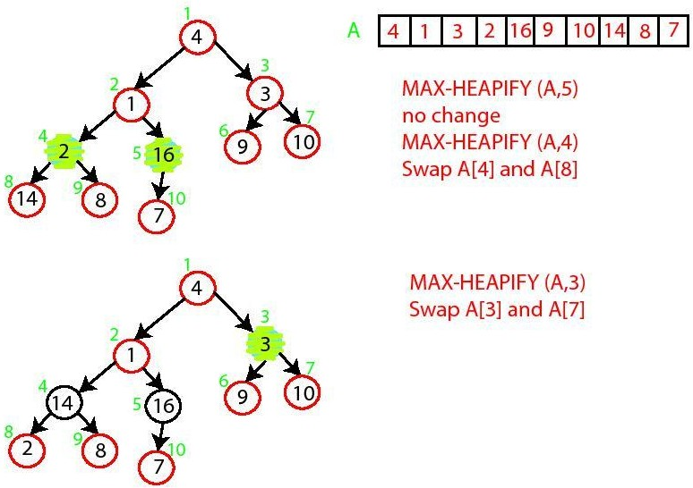
Build-Max-Heap

Slide 9
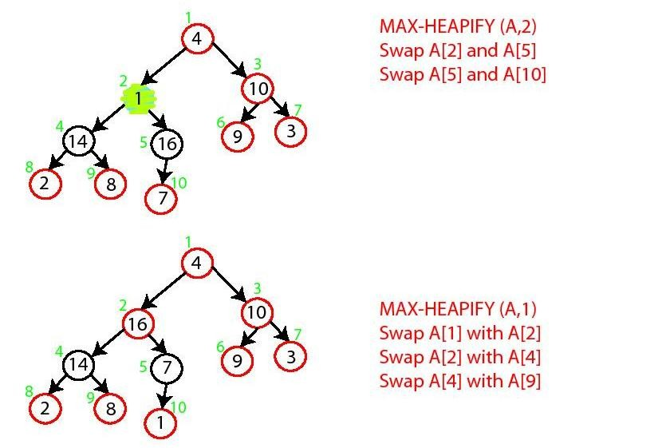
Build-Max-Heap

Slide 10
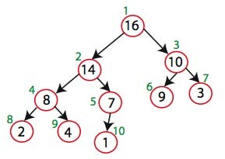

Build-Max-Heap

Slide 11
Heap-Sort Algorithms
Heap Sort Algorithm:-
Build Max Heap from unordered array
For i= Heap-size to 2
Swap elements A[Heap-size] and A[1]:
Heap-size=Heap-size -1
Max-Heapify(A, 1)
The complexity is O(n logn)

Slide 12

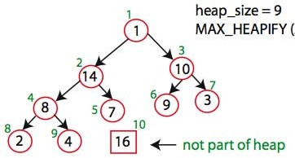

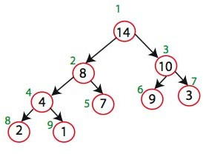

Heap-Sort
Swap A[10] and A[1]
Max_heapify(A,1)

Slide 13
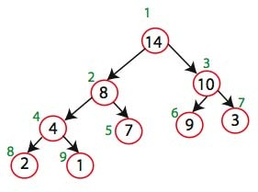

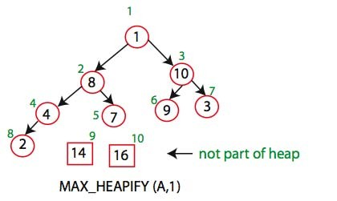
Heap-Sort
Swap A[9] and A[1]

Slide 14
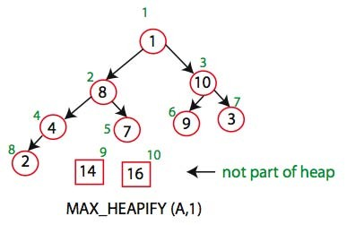
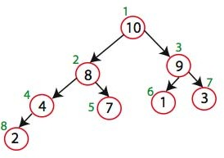
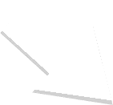
Heap-Sort

Slide 15
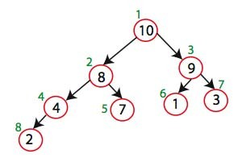
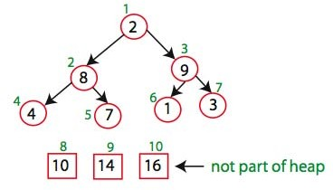

Heap-Sort
Swap A[8] and A[1]

